Slide 1


PYTHON
Lecture 7

Slide 2

Today’s Agenda
Concatenating Strings
The Slice Operator In Strings
Three Important String Functions
Type Conversion

Slide 3
String Concatenation
Concatenation means joining two or more strings together
To concatenate strings, we use the + operator.
Keep in mind that when we work with numbers, + will be an operator for addition, but when used with strings it is a joining operator.

Slide 4
String Concatenation
Example:
s1=“Good”
s2=“Morning”
s3=s1+” “+s2
print(s3)
Output:
Good Morning
Example:
s1=“Good”
s2=“Morning”
s3=s1+s2
print(s3)
Output:
GoodMorning

Slide 5
The Slicing Operator
Slicing means pulling out a sequence of characters from a string .
For example , if we have a string “Industry” and we want to extract the word “dust” from it , then in Python this is done using slicing.
To slice a string , we use the operator[ ] as follows:
Syntax: s[x:y]
x denotes the start index of slicing and y denotes the end index . But Python ends slicing at y-1 index.

Slide 6
The Slicing Operator
Example:
s=“Welcome”
print(s[3:6])
Output:
com
Example:
s=“Industry”
print(s[2:6])
Output:
dust

Slide 7
The Slicing Operator
Example:
s=“Mumbai”
print(s[0:10])
Output:
Mumbai
Example:
s=“Mumbai”
print(s[0:3])
Output:
Mum

Slide 8
The Slicing Operator
Example:
s=“Python”
print(s[6:10])
Output:
Example:
s=“Python”
print(s[2:2])
Output:

Slide 9
The Slicing Operator
Example:
s=“welcome”
print(s[:3])
Output:
wel
Example:
s=“welcome”
print(s[1:])
Output:
elcome

Slide 10
The Slicing Operator
Example:
s=“welcome”
print(s[])
Output:
Syntax Error
Example:
s=“welcome”
print(s[:])
Output:
welcome

Slide 11
The Slicing Operator
Example:
s=“welcome”
print(s[-1:-4])
Output:
Example:
s=“welcome”
print(s[-4:-1])
Output:
com

Slide 12
Using Step Value
String slicing can accept a third parameter also after the two index numbers.
The third parameter is called step value.
So the complete syntax of slicing operator is:
s[begin:end:step]
Step value indicates how many characters to move forward after the first character is retrieved from the string and it’s default value is 1 , but can be changed as per our choice.

Slide 13
The Slicing Operator
For Example:
s=“Industry”
print(s[2:6])
Output:
dust
Can also be written as :
s=“Industry”
print(s[2:6:1])
Output:
dust
s=“Industry”
print(s[2:6:2])
Output:
ds

Slide 14
Three Very Useful Functions/Methods Of String Data Type
Python provides us some very useful functions/methods for performing various operations on String values.
Following are these functions/methods:
len()
lower()
upper()

Slide 15

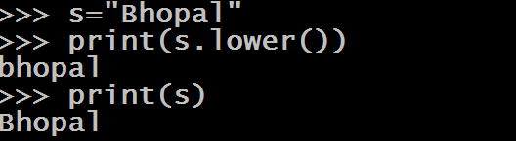
Three Very Useful Functions/Methods Of String Data Type
len() : Returns length of the String passed as argument
Syntax: len(s)
lower() : Returns a copy of calling String object with all letters converted to lowercase
Syntax: s.lower()

Slide 16
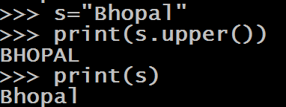
Three Very Useful Functions/Methods Of String Data Type
upper() : Returns a copy of calling String object with all letters converted to uppercase
Syntax: s.upper()

Slide 17
Comparing Strings
We can use ( > , < , <= , <= , == , != ) to compare two strings.
Python compares string lexicographically i.e using UNICODE value of the characters.

Slide 18
Comparing Strings
Suppose we have str1 as " Indore " and str2 as " India" and we write print(str1>str2) , then Python will print True. Following is the explanation
Now the first two characters from str1 and str2 ( I and I ) are compared.
As they are equal, the second two characters are compared.
Because they are also equal, the third two characters ( d and d ) are compared.
Since they also are equal , the fourth pair (o and i) is compared and there we get a mismatch .
Now because o has a greater UNICODE value than i so Indore is greater than India and so the answer is True

Slide 19
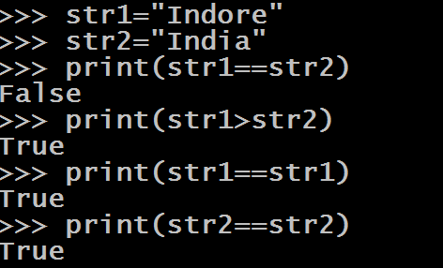
Comparing Strings

Slide 20
Type Conversion
The process of converting the value of one data type (integer, string, float, etc.) to another data type is called Type Conversion.
Python has two types of type conversion.
Implicit Type Conversion
Explicit Type Conversion

Slide 21
Implicit Conversion
In Implicit Type Conversion, Python automatically converts one data type to another data type.
This process doesn't need any programmer involvement.
Let's see an example where Python promotes conversion of int to float .

Slide 22
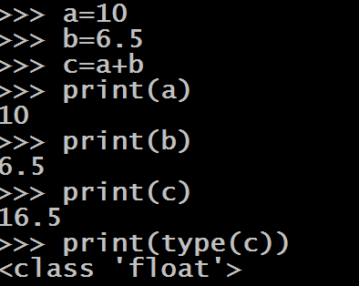
Example Of Implicit Conversion
If we observe the above operations , we will find that Python has automatically assigned the data type of c to be float .
This is because Python always converts smaller data type to larger data type to avoid the loss of data.

Slide 23
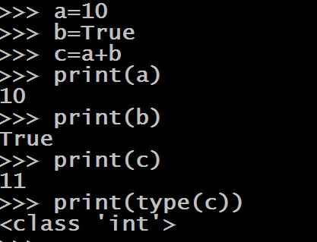
Another Example
Here also Python is automatically upgrading bool to type int so as to make the result sensible

Slide 24
Explicit Type Conversion
There are some cases , where Python will not perform type conversion automatically and we will have to explicitly convert one type to another.
Such Type Conversions are called Explicit Type Conversion
Let's see an example of this

Slide 25
Explicit Type Conversion
Guess the output ?
a=10
b=“6”
print(type(a))
print(type(b))
c=a+b
print( c )
print(type( c ))
Output:
<class ‘int’>
<class ‘str’>
TypeError: unsupported operand type(s) for +: 'int' and 'str'
Why did the code fail?
The code failed because
Python does not automatically convert
String to int.
To handle such cases we need to
perform Explicit Type Conversion

Slide 26
Explicit Type Conversion Functions In Python
Python provides us 5 predefined functions for performing Explicit Type Conversion for fundamental data types.
These functions are :
int()
float()
complex()
bool()
str()

Slide 27
The int( ) Function
Syntax: int(value)
This function converts value of any data type to integer , with some special cases
It returns an integer object converted from the given value

Slide 28
int( ) Examples
int(2.3)
Output:
2
int(False)
Output:
0
int(True)
Output:
1
int(3+4j)
Output:
TypeError: Can’t convert complex to int
int() cannot convert complex type to int type

Slide 29
int( ) Examples
int() cannot accept anything other than digits in a string
int(“25”)
Output:
25
int(“2.5”)
Output:
ValueError: Invalid literal for int()
int(“1010”)
Output:
1010
int(“0b1010”)
Output:
ValueError: Invalid literal for int()
int() cannot accept binary values as string

Slide 30
Solution To The Previous Problem
Can you solve this error now ?
a=10
b=“6”
c=a+b
print( c )
Output:
TypeError
Solution:
a=10
b=“6”
c=a+int(b)
print( c )
Output:
16

Slide 31
The float( ) Function
Syntax: float(value)
This function converts value of any data type to float , with some special cases
It returns a float object converted from the given value

Slide 32
float( ) Examples
float(25)
Output:
25.0
float(False)
Output:
0.0
float(True)
Output:
1.0
float(3+4j)
Output:
TypeError: Can’t convert complex to float
float() cannot convert complex type to float type

Slide 33
float( ) Examples
float(“25”)
Output:
25.0
float(“2.5”)
Output:
2.5
float(“1010”)
Output:
1010.0
float (“0b1010”)
Output:
ValueError:Could not convert string to float
float(“twenty”)
Output:
ValueError:Could not convert string to float
float() cannot accept any int value other than base 10 as string

Slide 34
The complex( ) Function
Syntax: complex(value)
This function converts value of any data type to complex , with some special cases
It returns an complex object converted from the given value

Slide 35
complex ( ) Examples
complex(25)
Output:
(25+0j)
complex(2.5)
Output:
(2.5+0j)
complex(True)
Output:
(1+0j)
complex(False)
Output:
0j

Slide 36
complex( ) Examples
complex(“25”)
Output:
(25+0j)
complex(“2.5”)
Output:
(2.5+0j)
complex(“1010”)
Output:
(1010+0j)
complex (“0b1010”)
Output:
ValueError: complex() arg is a malformed string
complex(“twenty”)
Output:
ValueError: complex() arg is a malformed string
complex() cannot accept any int value other than base 10 as string

Slide 37
The bool ( ) Function
Syntax: bool(value)
This function converts value of any data type to bool , using the standard truth testing procedure.
It returns an bool object converted from the given value

Slide 38
The bool ( ) Function
What values are considered to be false and what values are true ?
The following values are considered false in Python:
None
False
Zero of any numeric type. For example, 0, 0.0, 0+0j
Empty sequence. For example: (), [], ''.
Empty mapping. For example: {}
All other values are true

Slide 39
bool( ) Examples
bool(1)
Output:
True
bool(5)
Output:
True
bool(0)
Output:
False
bool(0.0)
Output:
False

Slide 40
bool( ) Examples
bool(0.1)
Output:
True
bool(0b101)
Output:
True
bool(0b0000)
Output:
False
bool(2+3j)
Output:
True
bool() returns True if any of the real or imaginary part is non zero . If both are zero it returns False

Slide 41
bool( ) Examples
bool(“twenty”)
Output:
True
bool(' ')
Output:
True
bool(0+1j)
Output:
True
bool(0+0j)
Output:
False
bool('')
Output:
False
bool('A')
Output:
True
bool() returns False for empty Strings otherwise it returns True

Slide 42
The str( ) Function
Syntax: str(value)
This function converts any data type to string , without any special cases
It returns a String object converted from the given value

Slide 43
str( ) Examples
str(15)
Output:
‘15’
str(2.5)
Output:
‘2.5’
str(2+3j)
Output:
‘(2+3j)’
str(True)
Output:
‘True’

Slide 44
str( ) Examples
str(1)
Output:
‘1’
str(5)
Output:
‘5’
str(2.5)
Output:
‘2.5’
str(True)
Output:
‘True’

